Slide 1

Digital Design
Authority
Cloud
Standard

Slide 2




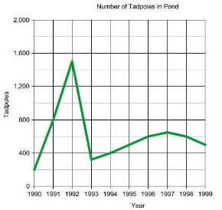
Cloud Standard
Find the full standard here: xxxxx
For help and advice contact: xxxxxx
Profiles
Service profiles will be developed to allow for reuse of successful hosting approaches
Technical Protocols
Standards (e.g. ISO17788 will be used to describe services. Individual service elements will build on standards appropriate in those areas
Interoperability
Portability of services will be considered and where appropriate designed for portability and interoperability across providers
Governance
Security
We will build-in consideration of security in hosting practice (e.g. ISO27018)
Governance
With appropriate metrics will be in place to ensure appropriate use and financial governance.

